Slide 1
C-RAVE:
Looking at Methods for raising Awareness of Linguistic Gender Stereotyping using Virtual Simulation Applications from a cross-cultural perspective:
the Seychelles and Sweden
Anders Steinvall & Mats Deutschmann
Umeå University, Sweden

Slide 2
Two projects on awareness-raising activities
RAVE – Raising Awareness through Virtual Experiencing (VR funded)
C-RAVE – A Cross-cultural perspective on Raising Awareness through Virtual Experiencing (Wallenberg funded)
Both primarily address issues relating to language and stereotyping

Slide 3
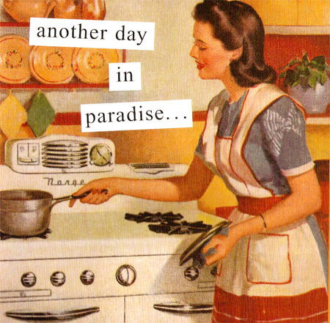
Instances of social stereotypes
“Once I didn’t talk to my wife for six months”
“I didn’t want to interrupt”

Slide 4
Conversational styles
Collaborative
Sympathy
Rapport
Listening
Private
Intimacy
Connection
Supportive
Competitive
Problem-solving
Report
Lecturing
Public
Independence
Status
Oppositional

Slide 5
Gender and language – a binary distinction?
Collaborative style
Feminine
Competitive style
Masculine
Collaborative style
Competitive style
Hegemonic femininity
Hegemonic masculinity
Challenging discourses
Notes:
Remember to address the problems when we have mixed-sex conversations.

Slide 6
The problem addressed in the RAVE project
Most students know what is politically correct and have little awareness of their own preconceptions and prejudice
“I will have no stereotypical assumptions about my future students”
The theoretical knowledge from courses remains just that – factual knowledge (if remembered …)

Slide 7
What we want to achieve
Raising students’ awareness of their own linguistic stereotyping, biases and prejudice
In doing so, develop their factual knowledge into metacognitive knowledge

Slide 8
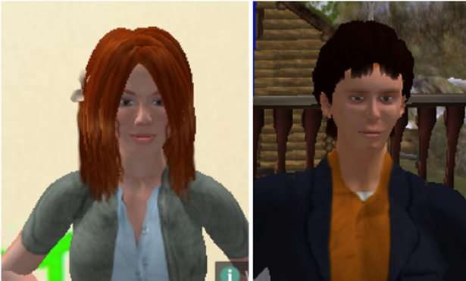
Tools and method
New digital media is well suited for different types of so-called match-guise experiments.
Prototype test in Second Life – a virtual world: https://www.youtube.com/watch?v=tyXlT3cNHRk
One person in the guise of two different teaching assistants: gender morphing and voice morphing

Slide 9
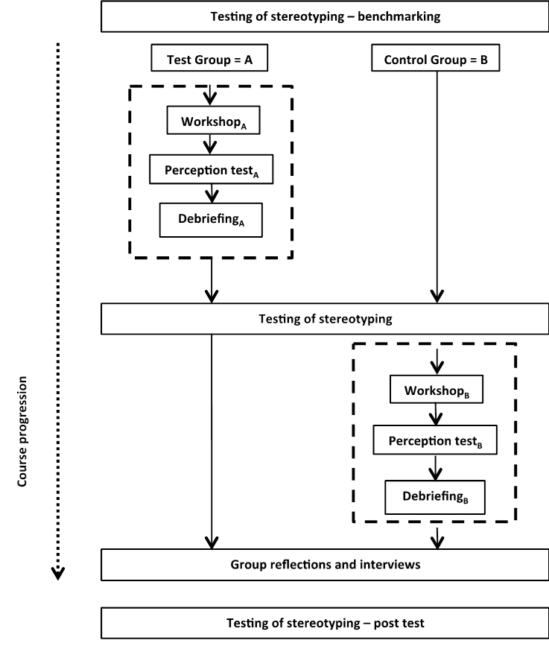
Tools and method, cont’d.
The new approach: rigour and KISS
Pre- and post-testing for implicit and explicit stereotypes
Voice-morphing followed by test and debriefing
Group reflections – for mature and higher level thinking

Slide 10
Pilot manipulation: Telephone discussion between two “researchers”: Robin Simpson and Terry Walker
Robin and Terry on Gender
Robin Simpson
Terry Walker

Slide 11
The manipulation set-up
Discussant | Robin (Collaborative) | Terry (Competitive)
Perceived gender for group A | Male | Female
Perceived gender for group B | Female | Male

Slide 12
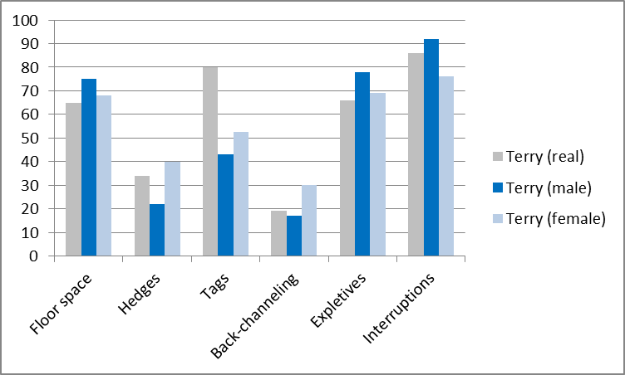
Comparing "Terry" data (competitive strategy)

Slide 13
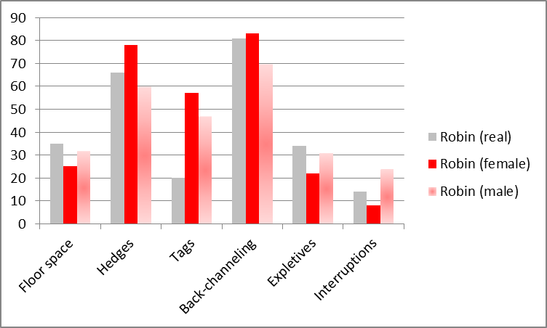
Comparing "Robin" data (collaborative strategy)

Slide 14
Students’ reactions to evaluative statements (II): The person in question is a good listener

Slide 15
Set-up Round 2 2 Adobe discussion between two “researchers”: Mats Deutschmann and Karyn (alias Jane/John Watts)l
There were two versions of the same texts
https://www.youtube.com/watch?v=bQ29FZ9tSq0
https://www.youtube.com/watch?v=oWthLSkH2mg

Slide 16
Discussant | Mats | “Karyn”
Perceived gender for group A | Male | Male
Perceived gender for group B | Male | female

Slide 17
Responses

Slide 18
Note the following
The male version gets higher scores for “Interruptions”
The male version gets higher scores for “takes a lot of space”
The male version gets higher scores for “contradicts”
All of these features are considered part of competitive speech, which is deemed stereotypically male.

Slide 19
Some students’ comments after the debriefing session
“This made me so much more aware about it and the whole issue. Not only the experiment but the whole course and even though I do generalize and I have clear stereotypes I am now more aware of them and can use that knowledge in the classroom and even in life in general!”
“I feel like I learned more when I was actively participating in the tests during the course.”
“Good and interesting! I have gotten a deeper understanding of how I look at stereotypes and how that will affect me in my future work!”

Slide 20
Conclusion from RAVE pilot rounds
Students were more inclined to agree with statements that fit stereotypes (i.e. when Robin was female and Terry male/Karyn behaved x or y).
Students seem to be influenced by stereotypes in their listening (but this is not conclusive yet).
In particular, there seems to be a tendency to exaggerate stereotypically male features when the speaker is ‘male’.
The debriefing session appears to have stimulated students into meta-cognitive reflection.

Slide 21
Our biggest challenges
Sound quality of our material
Has to be conceived as authentic
Must not raise suspicion that the material has been manipulated for gender
How do we measure whether students have become more aware?
IAT, explicit sexism scale
ELSAT- Explicit Language Stereotyping Awareness test.

Slide 22
C-RAVE: Applications to the Seychelles context
A relevant expansion because
Conspicuous lack of studies from non-Western countries
Need for identification of conversational strategies
Identification of beliefs about conversations
A more complex gender picture: mix of traditional roles and progressive/ matriarchal tendencies
A lens for exploring similarities and differences compared to a European perspective

Slide 23
Finally
We are more than happy for constructive input for the next phase

Slide 24
Thank you!

